Slide 1
History of Database Systems
Jiannan Wang
Simon Fraser University
Notes:
Two parts

Slide 2
Database Systems in a Half Century (1960s – 2020s)
When | What
Early 1960 – Early 1970 | The Navigational Database Empire
Mid 1970 – Mid 1980 | The Database World War I
Mid 1980 – Early 2000 | The Relational Database Empire
Mid 2000 – Now | The Database World War II
References.
https://en.wikipedia.org/wiki/Database#History
What Goes Around Comes Around (Michael Stonebraker, Joe Hellerstein)
40 Years VLDB Panel

Slide 3
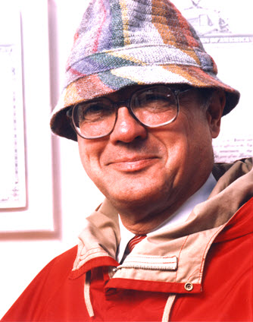
The Navigational Database Empire (Early1960 – Early 1970)
Data Model
How to organize data
How to access data
Navigational Data Model
Organize data into a multi-dimensional space (i.e., A space of records)
Access data by following pointers between records
Inventor: Charles Bachman
The 1973 ACM Turing Award
Turing Lecture: “The Programmer As Navigator”

Slide 4
The Navigational Database Empire (Early1960 – Early 1970)
Representative Navigational Database Systems
Integrated Data Store (IDS), 1964, GE
Information Management System (IMS), 1966, IBM
Integrated Database Management System (IDMS), 1973, Goodrich
CODASYL
Short for “Conference/Committee on Data Systems Languages”
Define navigational data model as standard database interface (1969)

Slide 5
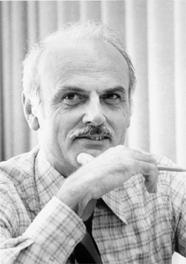
The Birth of Relational Model
Ted Codd
Born in 1923
PHD in 1965
“A Relational Model of Data for Large Shared Data Banks” in 1970
Relational Model
Organize data into a collection of relations
Access data by a declarative language (i.e., tell me what you want, not how to find it)
Data Independence

Slide 6
The Database World War I: Background
One Slide (Navigational Model)
Led by Charles Bachman (1973 ACM Turing Award)
Has built mature systems
Dominated the database market
The other Slide (Relational Model)
Led by Ted Codd (mathematical programmer, IBM)
A theoretical paper with no system built
Little support from IBM

Slide 7
The Database World War I: Three Big Campaigns
1. Which data model is better in theory?
(Mid 1970)
2. Which data model is better in practice?
(Late 1970 – Early 1980)
3. Which data model is better in business?
(Early 1980 – Mid 1980)

Slide 8
The “Theory” Campaign
A debate at ACM SIGFIDET (precursor of SIGMOD) 1974
Navigational model is bad
Data Organization: So complex
Data Access: No declarative language
Relational model is bad
Data Organization: A special case of navigational model
Data Access: No system proof that declarative language is viable

Slide 9


The “Practice” Campaign
The Big Question
Can a relational database system perform as good as a navigational system?
System prototypes
Ingres at UC Berkeley (early and pioneering)
System R at IBM (arguably got more stuff “right”)
The System R Team
Query Optimization (Patricia P. Griffiths et al.)
SQL ( Donald D. Chamberlin et al.)
Transaction (Jim Gray et al.)
Notes:
Trust computers with my money; e-commerce

Slide 10
The “Business” Campaign
Commercialization of Relational Database Systems
Not as easy as we thought
Three reasons (required) that led relational database systems to won
The minicomputer revolution (1977)
Competing products (e.g. IDMS) could not be ported to the minicomputer
Relational front end was not added to navigational database systems

Slide 11
What Can We Learn?
Lesson 1.
Lesson 2.
Lesson 3.
The winning of theory
The winning of practice
The winning of practice
The winning of business
Everyone can get a chance to win

Slide 12
The Relational Database Empire (Mid1980 – Early 2000)
Parallel and distributed DBs (1980 – 1990)
SystemR*, Distributed Ingres, Gamma, etc.
Objected-oriented DB (1980 – 1990)
Objects: Data/Code Integration
Extensibility: User-defined functions, User-defined data types
MySQL and PostgresSQL (1990s)
Widely used open-source relational DB systems

Slide 13
Database Systems in a Half Century (1960s – 2020s)
When | What
Early 1960 – Early 1970 | The Navigational Database Empire
Mid 1970 – Mid 1980 | The Database World War I
Mid 1980 – Early 2000 | The Relational Database Empire
Mid 2000 – Now | The Database World War II
References.
https://en.wikipedia.org/wiki/Database#History
What Goes Around Comes Around (Michael Stonebraker, Joe Hellerstein)
40 Years VLDB Panel

Slide 14
The Database World War II: Background
Internet Boom (Early 2000)
Larger data volume that cannot be fit in a single machine
Faster data updates that cannot be handled by a single machine
Commercial distributed database systems are expensive ☹
Open-source database systems do not support distributed computing well ☹

Slide 15
A
OLTP
OLAP
OnLine Transaction Processing
OnLine Analytical Processing
Workload
High-frequent Updates + Small Queries
Workload
Low-frequent Updates + Big Queries

Slide 16
The Database World War II: Two Big Campaigns
Which is better for (distributed) OLTP:
NoSQL vs. Relational DBMS?
Which is better for (distributed) OLAP:
MapReduce vs. Relational DBMS?

Slide 17
The Database World War II: Two Big Campaigns
Which is better for OLTP:
NoSQL vs. Relational DBMS?
Which is better for OLAP:
MapReduce vs. Relational DBMS?

Slide 18
What Happened To OLTP?
OldSQL (1970 – Now)
NoSQL (2000 – Now)
NewSQL (2010 – Now)

Slide 19
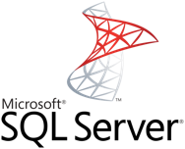
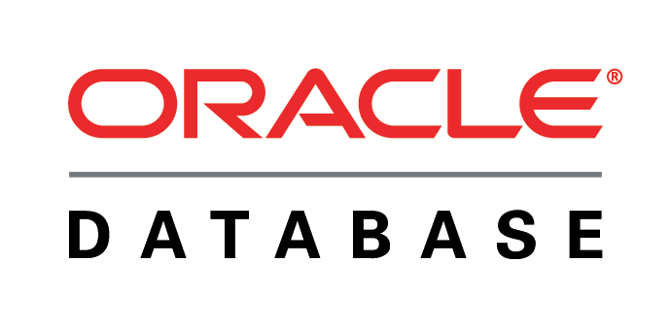

OldSQL (1970 – Now)
Traditional SQL vendors
Limitation 1: Not Scalable
Limitation 2: Pre-defined Schema
. . .
Still very big market!!!

Slide 20
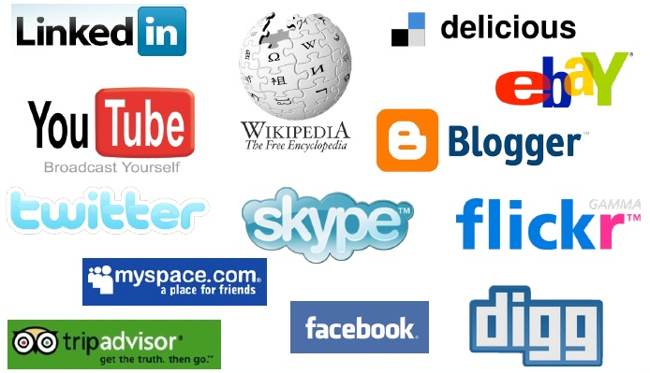
The advent of Web 2.0
Read-only Web → Read-write Web
Highly Scalable
Scale to1,000,000 users and 1000 servers
Highly Available
Available 24 hours a day, 7 days a week
Highly Flexible
Flexible schema and flexible data types

Slide 21
NoSQL Pioneers
Memcached [Fitzpatrick 2004]
In-memory indexes can be highly scalable
BigTable [Chang et al. 2006]
Persistent record storage could be scaled to thousands of nodes
Dynamo [DeCandia et al. 2007]
Eventual consistency allows for higher availability and scalability

Slide 22
NoSQL Categories
NoSQL | Data Model | Example Systems
Key-value Stores | Hash | DynamoDB, Riak, Redis, Membase
Document Stores | Json | SimpleDB, CouchBase, MongoDB
Wide-column Stores | Big Table | Hbase, Cassandra, HyperTable
Graph Database | Graph | Neo4J, InfoGrid, GraphBase
DynamoDB, Riak, Redis, Membase, SimpleDB, CouchBase, MongoDB, Hbase, Cassandra, HyperTable, Neo4J, InfoGrid, GraphBase, …

Slide 23
NoSQL Limitations
Low-level Language
Simple read/write database operators
Weak Consistency
Eventual Consistency
Lack of Standardization
100+ NoSQL systems

Slide 24
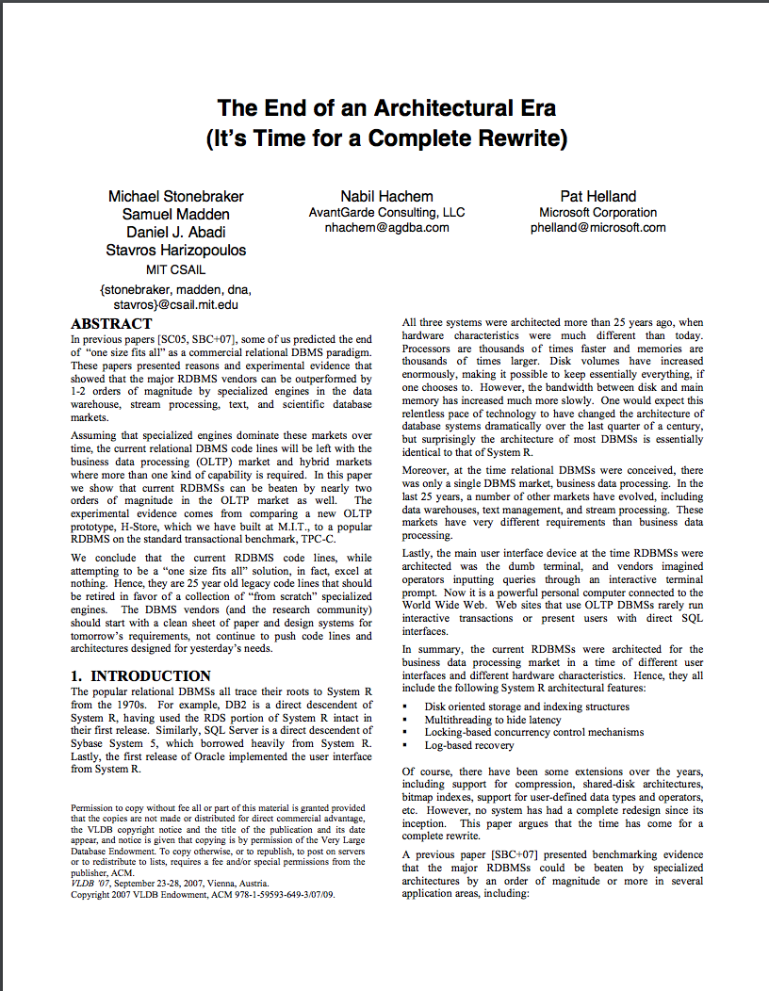
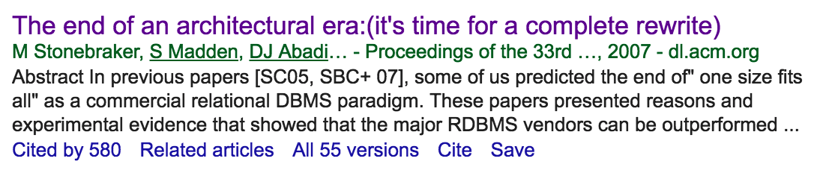
NewSQL
+
Strong Consistency High Scalability
90% query time spent on overhead

Slide 25
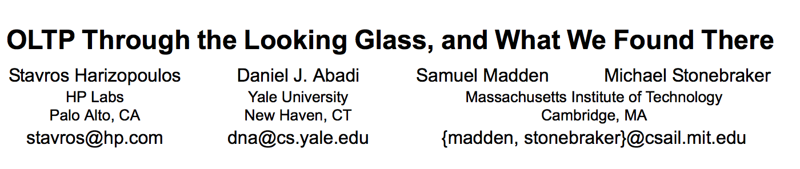
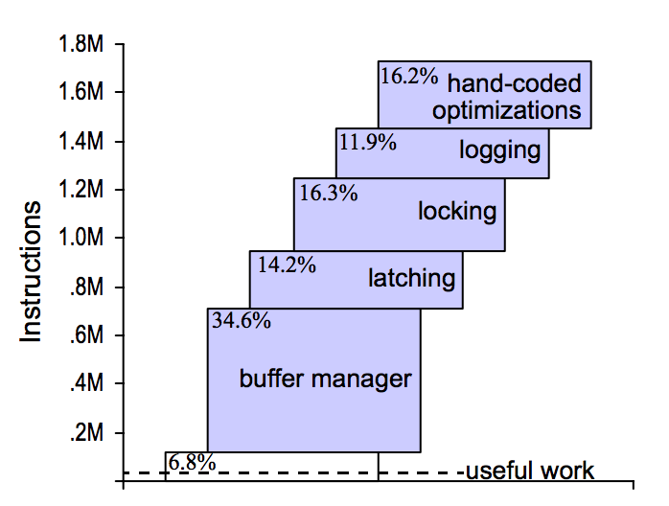

Slide 26
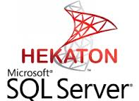


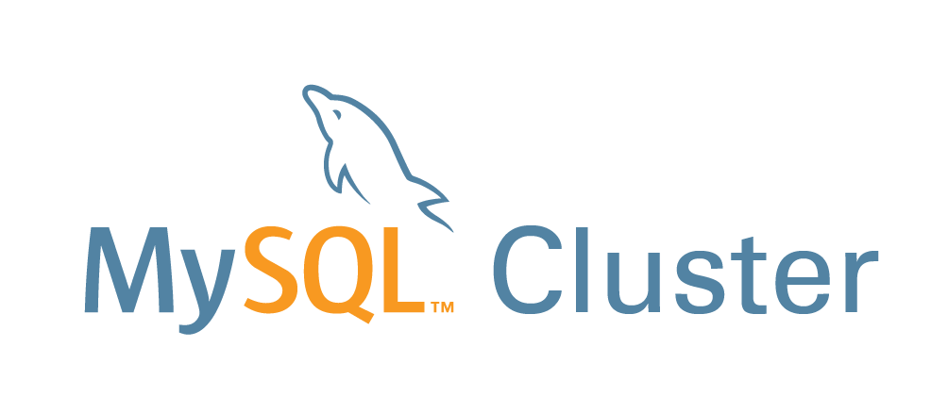




NewSQL Market
Limitations
Scalable but not highly scalable
Available but not highly available
Flexible but not highly flexible

Slide 27
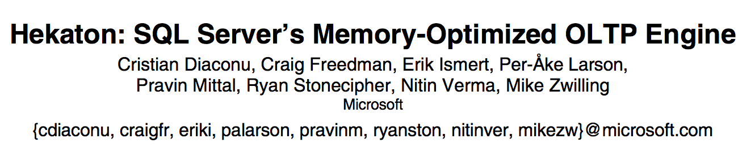
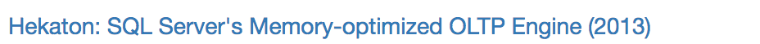


Slide 28

Summary
NewSQL
OldSQL
NoSQL
Why OldSQL?
Why NoSQL?
Why NewSQL?

Slide 29
The Database World War II: Two Big Campaigns
Which is better for OLTP:
NoSQL vs. Relational DBMS?
Which is better for OLAP:
MapReduce vs. Relational DBMS?

Slide 30
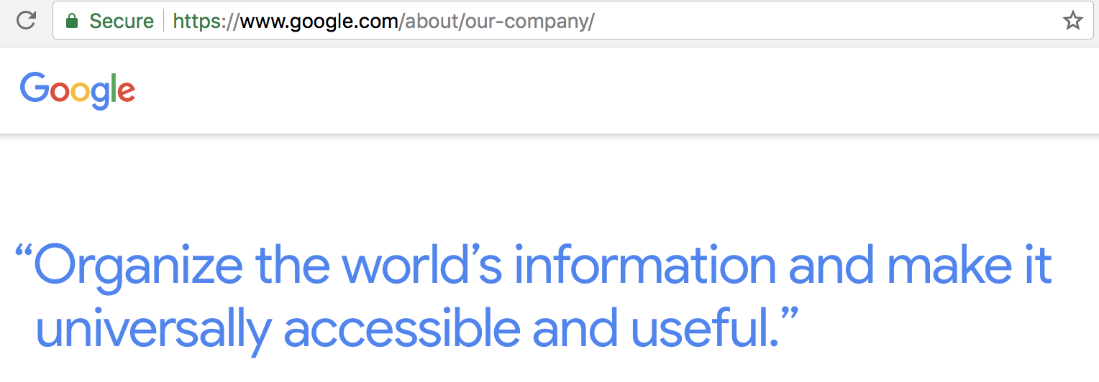
1 PB
= 100GB *10,000 Machines
How to store 1PB using 10,000 machines?
GFS (HDFS)
How to process 1PB using 10,000 machines?
MapReduce

Slide 31
Why MapReduce?
1. Fault Tolerant
(Your program will be OK when failures happen)
# of machines | Failure Probability
1 | 0.1%
10 | 0.9%
100 | 9.5%
1000 | 63.2%
10,000 | ???
Cost for 5 nodes | Failure Probability
$100/day | 0.1%
$1/day | 10%
Reserved Instance
Spot Instance
99.9%

Slide 32




Why MapReduce?
Machine
Learning
Graph
Processing
2. Complex Analytics
SQL
MapReduce
3. Heterogeneous
Storage Systems

Slide 33
The Great MapReduce Debate (2008-2010)
http://tiny.cc/mapreduce-debate

Slide 34
MapReduce vs. SQL
SELECT Map(v)
FROM Table
Map (k, v)
SELECT Reduce(v)
FROM Table
GROUP BY k
Reduce (k, v_list)

Slide 35


MapReduce: A Major Step Backwards
1. MapReduce is a step backwards in database access
2. MapReduce is a poor implementation
3. MapReduce is not novel
4. MapReduce is missing features
5. MapReduce is incompatible with the DBMS tools
Dewitt, D. and Stonebraker, M. MapReduce: A Major Step Backwards blogpost; January 17, 2008

Slide 36


Comments From The Other Side
vs.
MapReduce is a program model rather than a database system

Slide 37


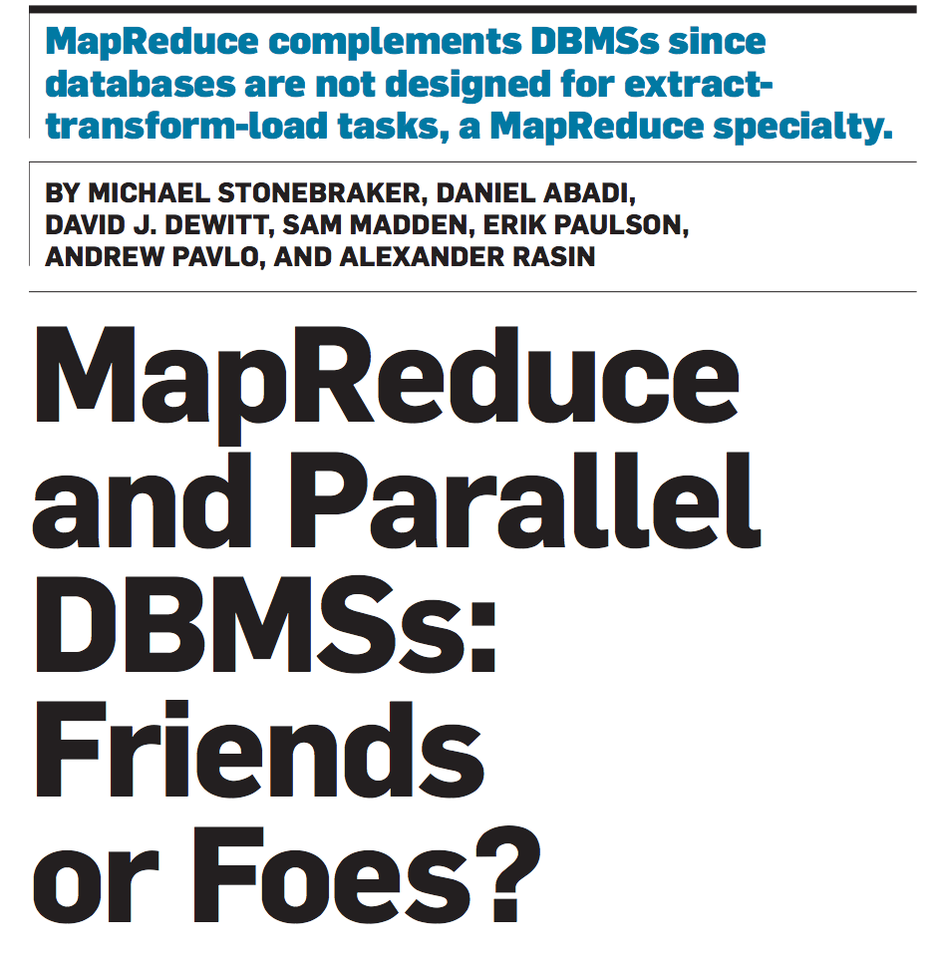
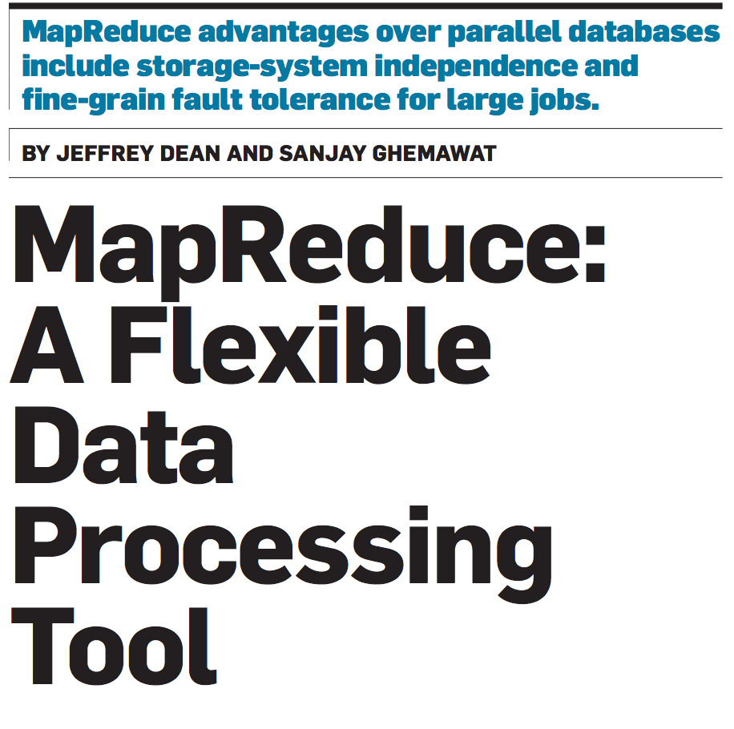
From Stonebraker et al.
From Dean and Ghemawat

Slide 38
What They Agree On?
Advantages of MapReduce:
Fault Tolerant
Complex Analytics
Heterogeneous Storage Systems
No Data Loading Requirement
Both should Learn from Each Other

Slide 39

Who won the debate?
Nobody is writing MapReduce code right now.
Many new systems (e.g., Spark, HIVE) were built on MapReduce

Slide 40
Trends
1 Hybrid Transactional and Analytical Processing
2. Cloud-Native Databases
3. Data Lake
4. Lakehouse = Data Lake + Data Warehouse

Slide 41
Summary
Why Relational Database? ( Mid 1970 – Now)
Why NoSQL? (Mid 2000 – Now)
Why MapReduce? (Mid 2000 – Now)

